Slide 1
Spam Detection on Twitter
By : Aviral Verma Kaustubh Justin

Slide 2
INTRODUCTION
Twitter gives users an opportunity to share their messages concerning everything identified with as genuine including news, occasions, celebrities, political issues, and so on.
Compared to various other social media platform, the connection between users is bi-directional rather than unidirectional connection
This means that a particular user may not be following one of his followers.
Twitter was overwhelmed by a lot of malignant tweets that were sent by a huge number of spammed users account; this occurred around April of 2014
The authentic users mistake the spam information for an important one. Spams are difficult to stop, email administrations such as Gmail, Microsoft and the likes have been effectively distinguishing spam messages; despite this fact, spam messages still exist online.

Slide 3
Present Mechanism
Twitter utilises both manual and mechanised administrations to fight spammers. The manual method involves Twitter giving users a chance to report spammers via the spammers' profile pages.
These manual methodologies are stressful and may not be sufficient to distinguish between all spammers because of billions of users.
The possessing of a huge number of spam protests documented against the account, the following/unfollowing of a huge number of accounts within a brief span, the publishing of a copy of the messages in a single account, the publishing of malignant connections etc are the ways in which Twitter aims to handle the spam accounts and tweets.
Twitter considers an account as spam “if a user posts multiple unrelated updates to a topic using the #symbol.” We count the number of hashtags in the 100 most recent tweets of the user, and this feature is used to classify as spam or real.

Slide 4
Tweets from Twitter
Twitter API tweepy is used to get tweets from the website.
In spam accounts, features like followers_count,favourites_count, profile_image, friends_count, geo_enabled, time_zone,location, will be very low.
At the same time, features like total_hashtags and total_links will be very high for spam accounts and spam tweets.
timeline = api.user_timeline(screen_name = user.screen_name, count = 100, include_rts = True) is the code to get information from Twitter
Here, api is tweepy.API

Slide 5
Data Categorization
Accounts that have verified attribute as TRUE are real accounts.
Tweets which do not have profile picture, background image, followers but use many links in the tweets and follow many accounts are spam.
Tweets which use many links, external links, URL shortener, defamatory abusive language can be classified as spam.
Manual checking of the rest of the tweets and accounts in order to classify as spam or real from the Twitter data.

Slide 6
Multinomial Naive Bayes
A Naive Bayes model assumes that each of the features it uses are conditionally independent of one another given some class.
Multinomial Naive Bayes classifier is a specific instance of a Naive Bayes classifier which uses a multinomial distribution for each of the features.
This works well for data which can easily be turned into counts, such as word counts in text. This is especially suitable for our data.

Slide 7
Multinomial Naive Bayes
This is a type of classifier which works on tokens, with spam or ham, in the tweets. It then uses Bayes theorem to calculate the probability that a particular tweet is spam or not.
The technique can classify almost any sort of data.
The Dataset used in our model has been created through the Twitter API. The API was used to retrieve information regarding the Tweets and their posting accounts. Since images cannot be processed, we instead use the links these images direct to, contained in the HTTP header of the image. The TweetTexts were concatenated with these links for more efficient spam detection mechanism.

Slide 8
Feature Selection
Favorite_Count, default_profile_image, followers_count, profile_use_background_image, retweet_count, friends_count, total_mentions, notifications, total_hashtags and sample_tweet.
The features that can individually categorise the account to spam or real account are profile_use_background_image, retweet_count, total_mentions, notifications, and total_hashtags.
The users are more concerned with spam accounts and tweets on Twitter because there is a high increase in spam account in the Twitter platform since its inception.
Average number of spam reports has been around 25,000 a day in 2017 to 17,000 a day in 2018.

Slide 9
Data Pre-processing
Data pre-processing involves the processes of Snowballing and TF-IDF Vectorization.
Snowballing consists of the following actions,
Separate the sentence into individual words
Convert all letters to lowercase
Remove stopwords
Don't care for non-English words

Slide 10
TF-IDF Vectorization
TF-IDF stands for term frequency-inverse document frequency.
The TF-IDF weight is a statistical measure used to evaluate how important a word is to a document in a collection or corpus.
The importance increases proportionally to the number of times a word appears in the document but is offset by the frequency of the word in the corpus.
TF: Term Frequency, which measures how frequently a term occurs in a document. TF(t) = (Number of times term t appears in a document) / (Total number of terms in the document)
IDF: Inverse Document Frequency, which measures how important a term is. While computing TF, all terms are considered equally important. However it is known that certain terms, such as "is", "of", and "that", may appear a lot of times but have little importance. IDF(t) = log_e(Total number of documents / Number of documents with term t in it)

Slide 11
Visualization
Using the occurrence weights obtained by TF_IDF Vectorization, we present a Word Cloud Visualization for spam and ham data.
A word cloud is a novelty visual representation of text data, typically used to depict keyword metadata (tags) on websites, or to visualize free form text.
Tags are usually single words, and the importance of each tag is shown with font size or color.
This format is useful for quickly perceiving the most prominent terms to determine its relative prominence.

Slide 12
Model Training
We scramble dataset and separate data for training and testing purposes. Scrambling is random.
We perform initial fitting of parameters on the training set and transform to a particular set of examples.
We extract the top features under the categories features_train, features_test, labels_train, labels_test. The top features extracted are used for improving the performance of the model.

Slide 13
Model Testing
We tested the trained model with the test data to obtain accuracy and F1 scores using Multinomial Naive Bayes and Bernoulli Naive.
The results showed the clear superiority of MNB over BNB.
The trained model is saved to be further used in real time spam detection in a tweet.

Slide 14
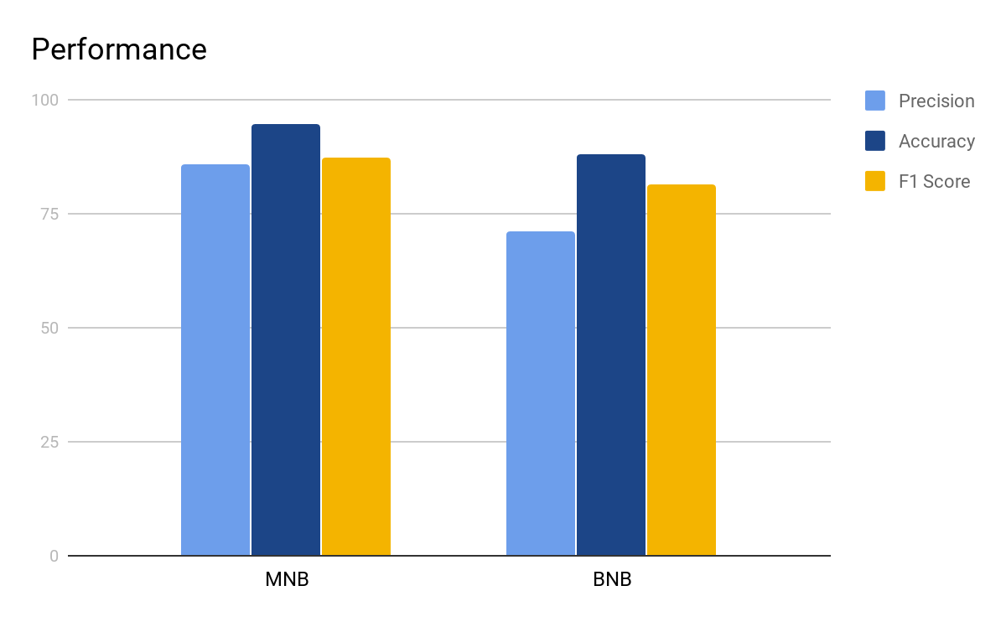

Slide 15
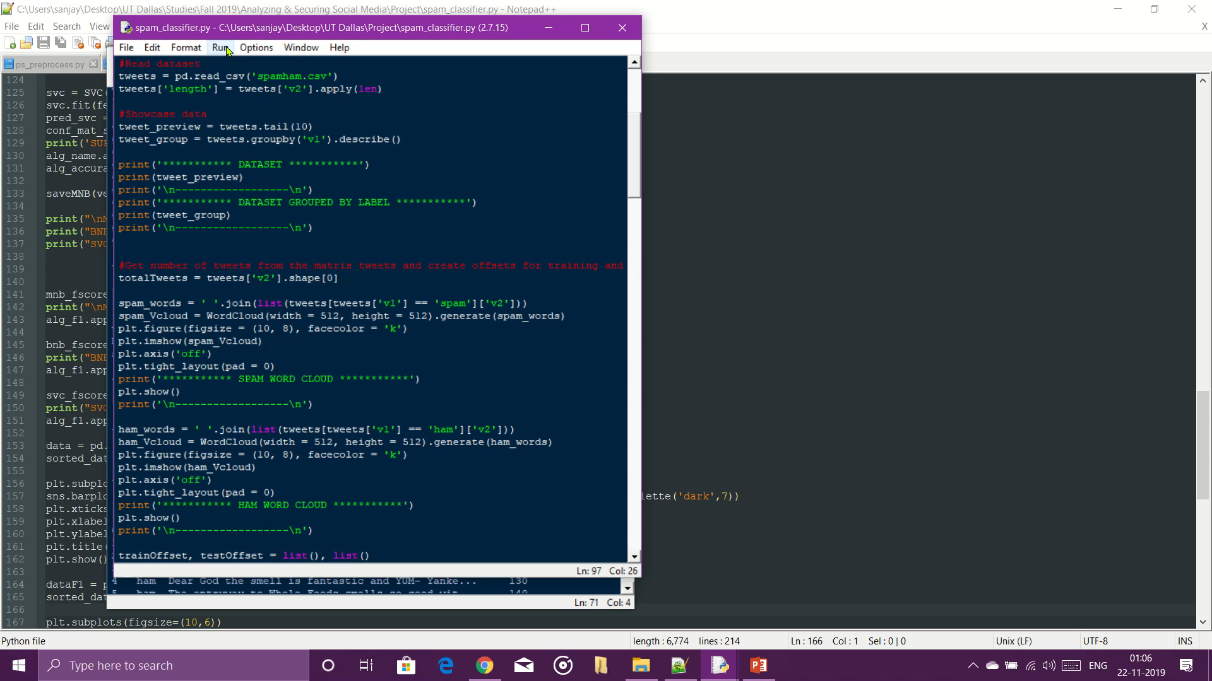

Slide 16
Classification
Twitter Authentication and tweet object catching functionalities are carried out using Tweepy
Using personal api endpoint/keys, we access live feed and extract the very last tweet.
We load the trained model.
Feed the extracted tweet into the model and predict Spamminess/Hamminess of that tweet.

Slide 17
References
http://www.ijirset.com/upload/2018/june/60_10_Spam.PDF
https://academicianhelp.co.uk/assets/sample-docs/Dissertation_-_Spam_Detection_on_Twitter_20180927123949.pdf
https://archive.ics.uci.edu/ml/machine-learning-databases/00228/

